Slide 1
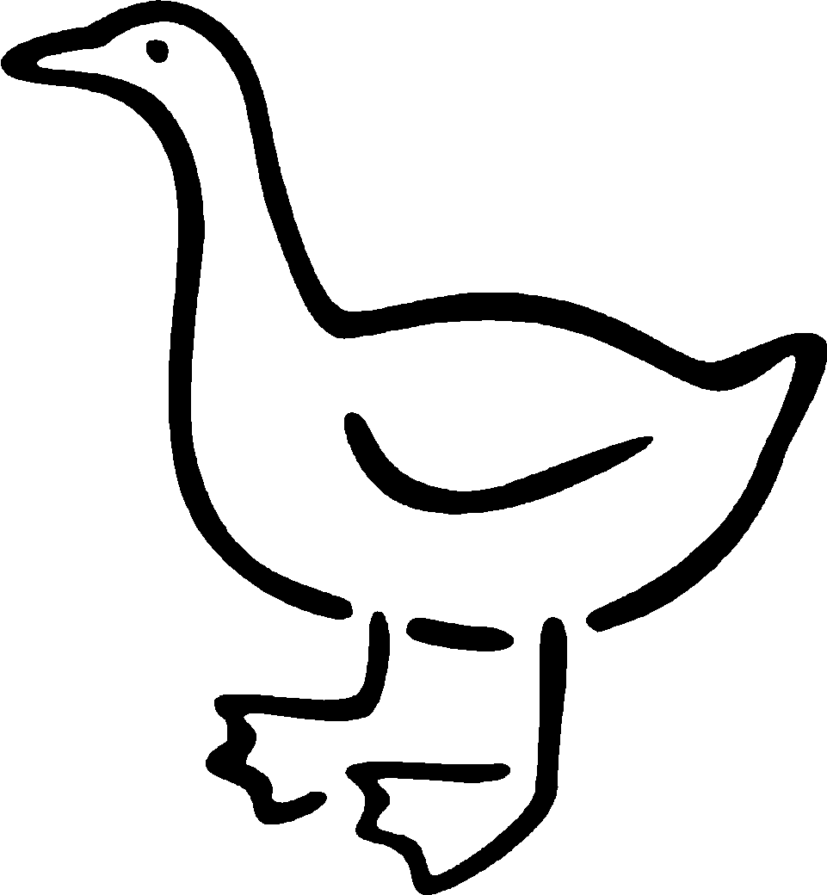
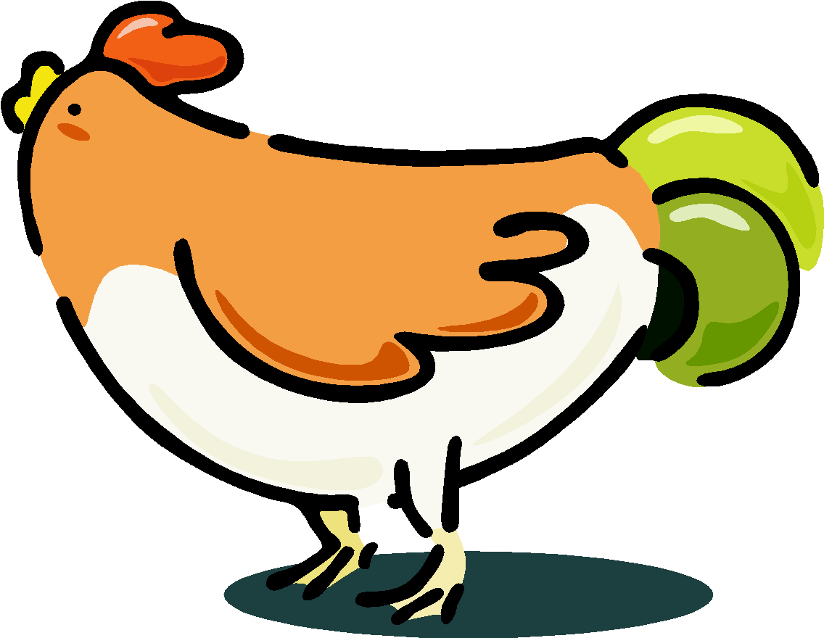

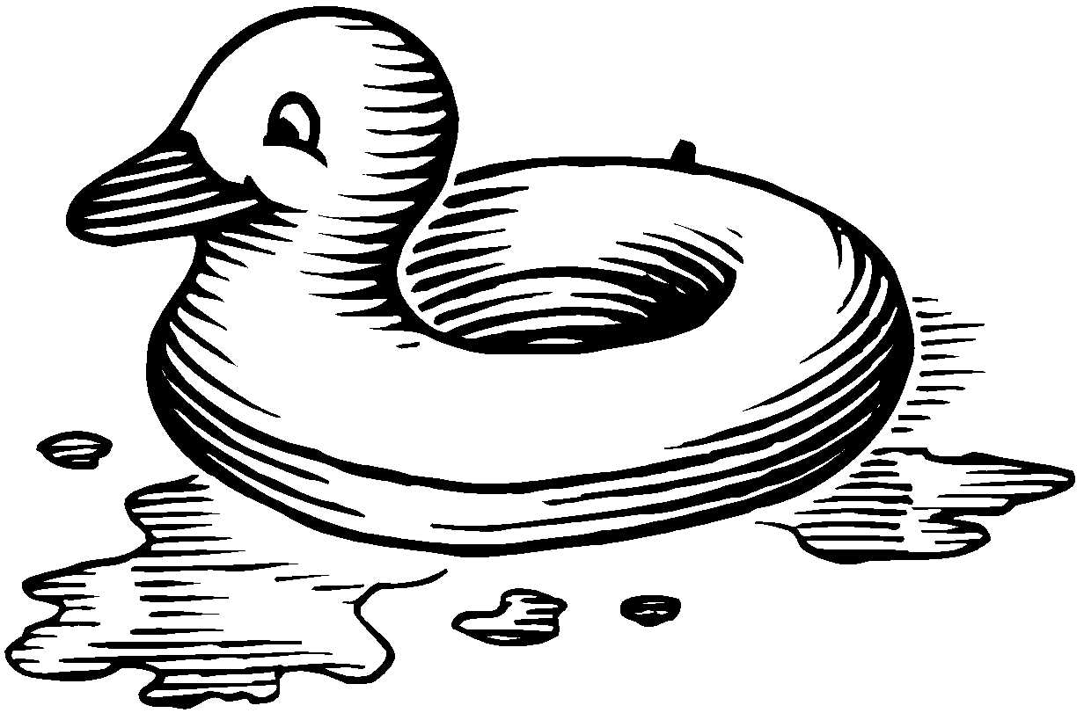
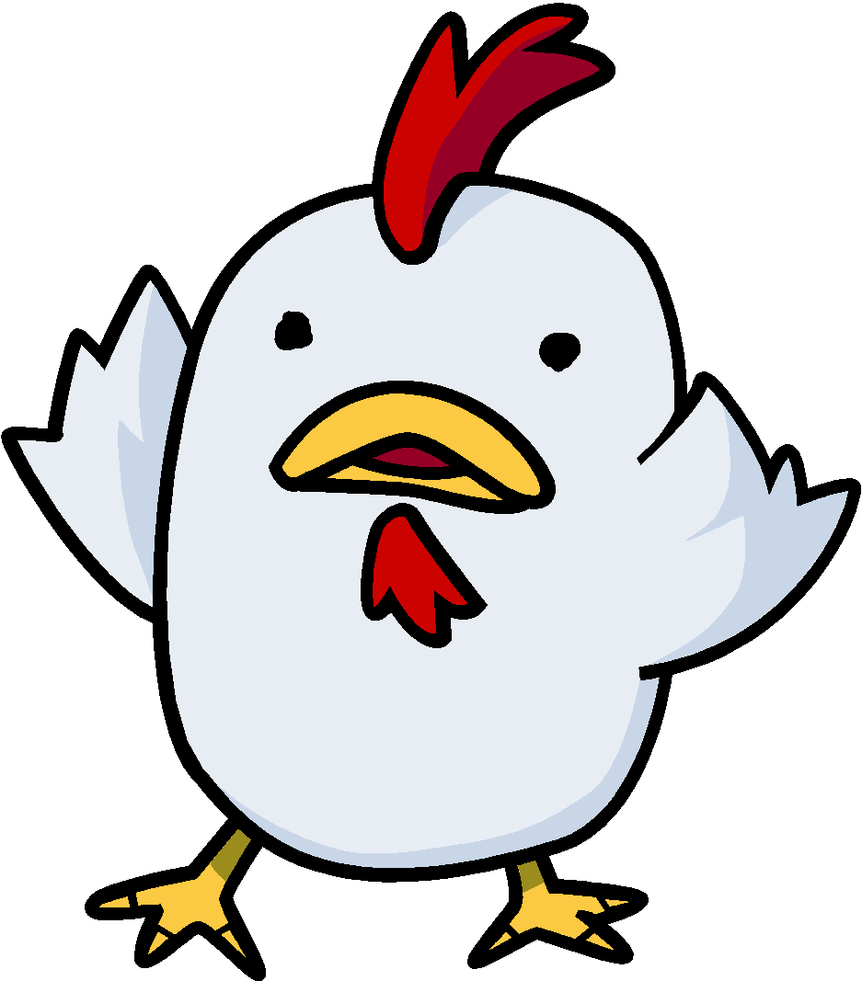

Nearest Neighbor Classifiers
Basic idea:
If it walks like a duck, quacks like a duck, then it’s probably a duck
Compute Distance
Test Record
Training Records
Choose k of the “nearest” records

Slide 2
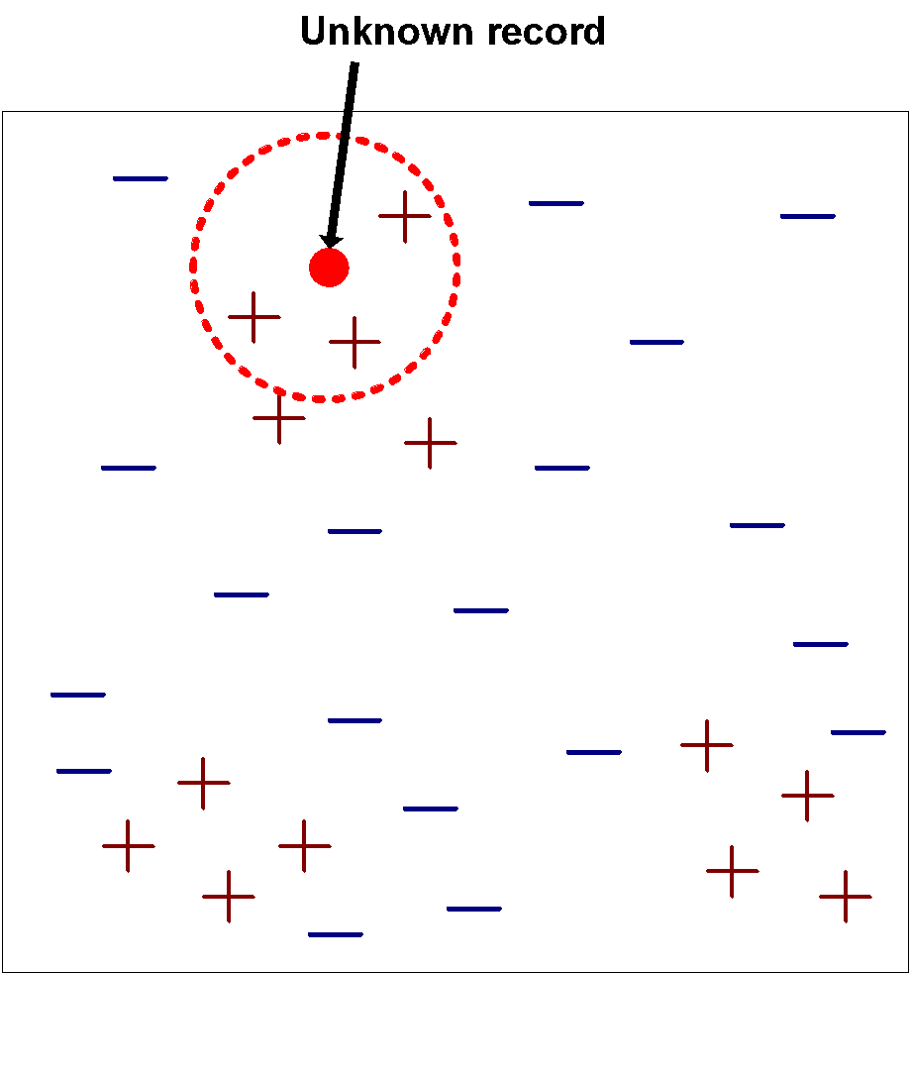
Nearest-Neighbor Classifiers
Requires the following:
A set of labeled records (supervised learning)
Proximity metric to compute distance/similarity between a pair of records
e.g., Euclidean distance, Manhattan distance
The value of k, the number of nearest neighbors to retrieve: how many neighbors you want to consider
A method for using class labels of K nearest neighbors to determine the class label of unknown record (e.g., by taking majority vote)

Slide 3
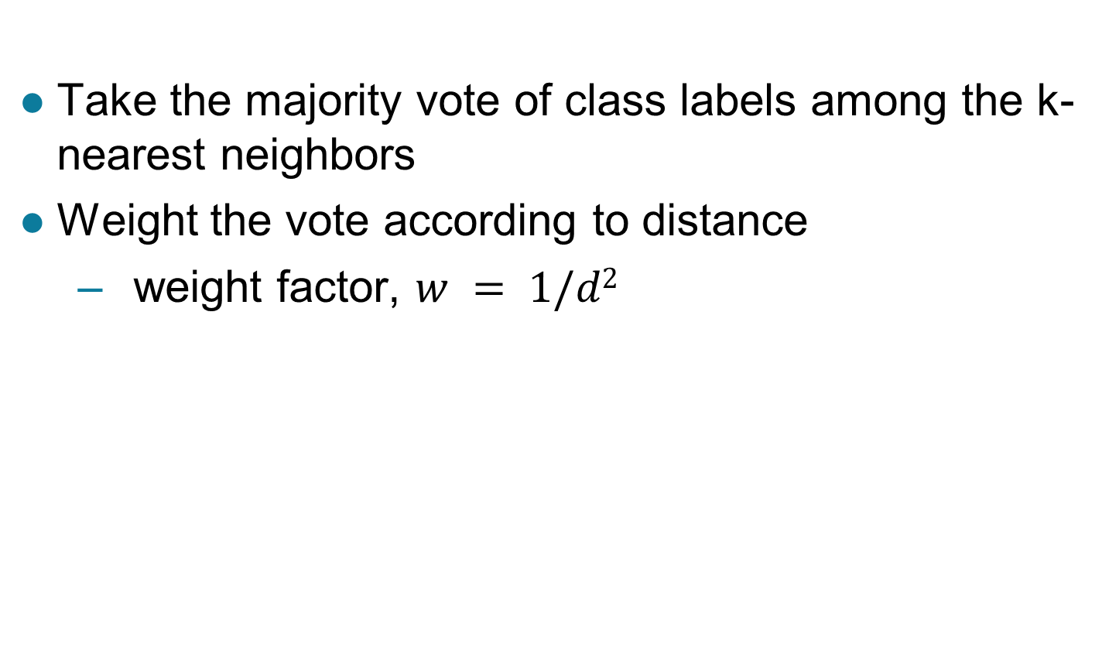
How to Determine the class label of a Test Sample?
: Unweighted voting

Slide 4
Query Types
Exact match query: Asks for the object(s) whose key matches query key exactly.
Range query: Asks for the objects whose key lies in a specified query range (interval).
Nearest-neighbor query: Asks for the objects whose key is “close” to query key.

Slide 5
Exact Match Query
Suppose that we store employee records in a database:
Asks for the object(s) whose key matches query key exactly.
ID Name Age Salary #Children
Example:
key=ID: retrieve the record with ID=12345

Slide 6
Range Query
Example:
key=Age: retrieve all records satisfying
20 < Age < 50
key= #Children: retrieve all records satisfying
1 < #Children < 4
ID Name Age Salary #Children

Slide 7
Nearest-Neighbor(s) (NN) Query
Example:
key=Salary: retrieve the employee whose salary is closest to $50,000 (i.e., 1-NN).
key=Age: retrieve the 5 employees whose age is closest to 40 (i.e., k-NN, k=5).
ID Name Age Salary #Children

Slide 8
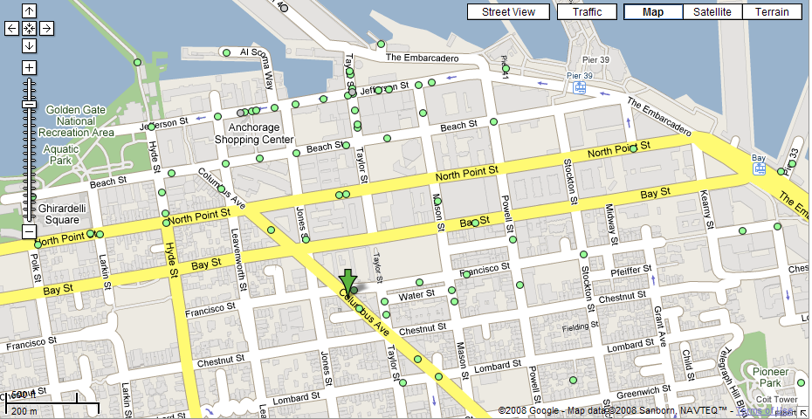
Nearest Neighbor(s) Query
What is the closest restaurant to my hotel?

Slide 9
Nearest Neighbor(s) Query (cont’d)
Find the 4 closest restaurants to my hotel

Slide 10
Multi-dimensional Query
In practice, queries might involve multi-dimensional keys.
key=(Name, Age): retrieve all records with
Name=“George” and “50 <= Age <= 70”
ID Name Age Salary #Children

Slide 11
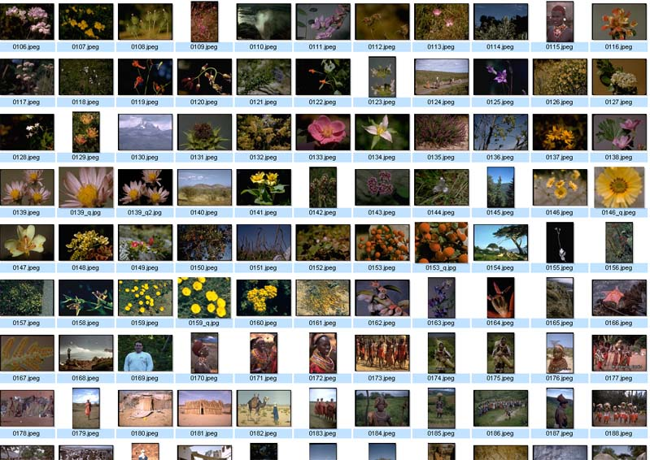
Nearest Neighbor Query in High Dimensions
Very important and practical problem!
Image retrieval
find N closest
matches (i.e., N
nearest neighbors)
(f₁,f₂, .., f_{k})

Slide 12
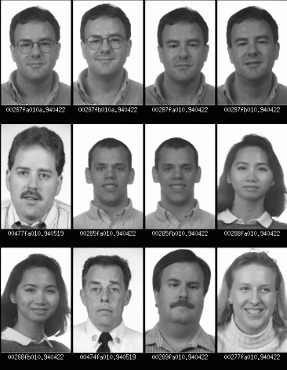
Nearest Neighbor Query in High Dimensions
Face recognition
find closest match
(i.e., nearest neighbor)

Slide 13
Interpreting Queries Geometrically
Multi-dimensional keys can be thought as “points” in high dimensional spaces.
Queries about records → Queries about points

Slide 14
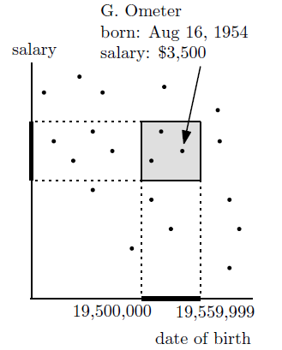
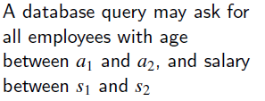
Example 1- Range Search in 2D
age = 10,000 x year + 100 x month + day

Slide 15
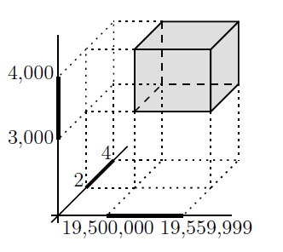
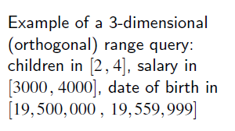
Example 2 – Range Search in 3D

Slide 16
Example 3 – Nearest Neighbors Search
QueryPoint
Measure point-to-point distance.

Slide 17
Nearest Neighbor Classification…
Data preprocessing is often required
Attributes MUST have to be scaled to prevent distance measures from being dominated by one of the attributes
Example:
height of a person may vary from 1.5m to 1.8m
weight of a person may vary from 90lb to 300lb
income of a person may vary from $10K to $1M
Time series are often standardized to have 0 means a standard deviation of 1

Slide 18
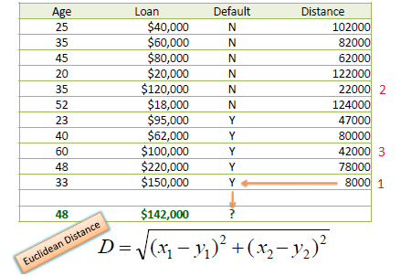
If K =3: Predicted class: Y (majority/unweighted)

Slide 19
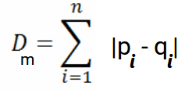
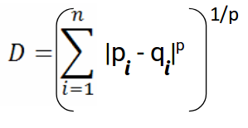
K-Nearest Neighbor (kNN)
kNN is a lazy learner algorithm because it does not learn from the training set immediately instead it stores the dataset and at the time of classification, it performs an action on the dataset
During the training phase, the KNN algorithm stores the entire training dataset as a reference
Manhattan distance: Manhattan Distance is the sum of absolute differences between points across all the dimensions
Minkowski Distance is the generalized form of Euclidean and Manhattan Distance
When the order is 1, both Minkowski and Manhattan Distance are the same
When the order is 2, we can see that Minkowski and Euclidean distances are the same

Slide 20
K-Nearest Neighbor (kNN)
When making predictions, it calculates the distance between the input data point and all the training examples, using a chosen distance metric such as Euclidean distance.
Next, the algorithm identifies the K nearest neighbors to the input data point based on their distances.
In the case of classification, the algorithm assigns the most common class label among the K neighbors as the predicted label for the input data point.
For regression, it calculates the average or weighted average of the target values of the K neighbors to predict the value for the input data point

Slide 21
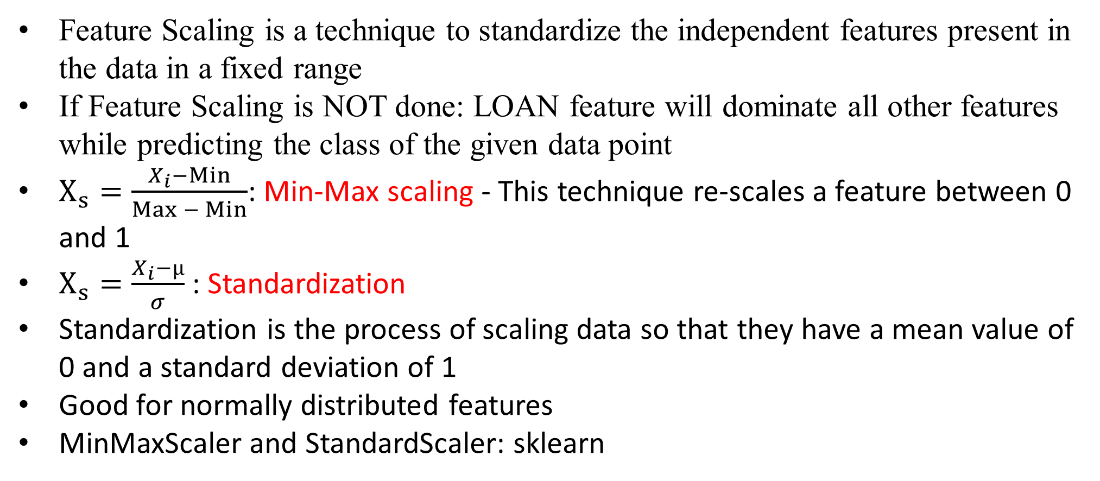
Need for Standardizing Attributes: Feature Scaling
Feature Scaling is a technique to standardize the independent features present in the data in a fixed range
If Feature Scaling is NOT done: LOAN feature will dominate all other features while predicting the class of the given data point
$X_{s}=\frac{X_{i}−Min}{Max − Min}$: Min-Max scaling - This technique re-scales a feature between 0 and 1
$X_{s}=\frac{X_{i}−µ}{σ}$ : Standardization
Standardization is the process of scaling data so that they have a mean value of 0 and a standard deviation of 1
Good for normally distributed features
MinMaxScaler and StandardScaler: sklearn

Slide 22
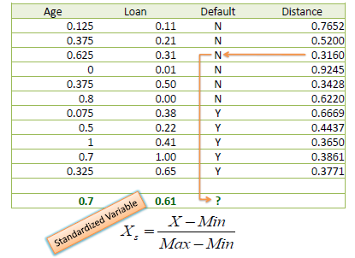
Need for Standardizing Attributes
: Min-Max scaling
If K =3: Predicted class: N (majority/unweighted)

Slide 23
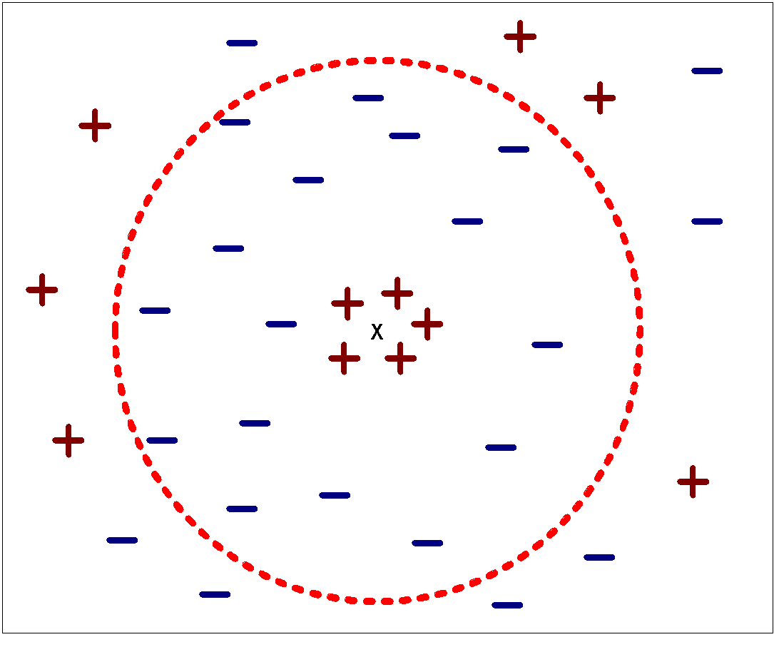
Nearest Neighbor Classification…
Choosing the value of k:
Min k = 1; Max k = # of samples
If k is too small, sensitive/vulnerable to noise points/outlier
If k is too large, neighborhood may include points from other classes: ZeroR classifier

Slide 24
kNN sklearn and hyperparameters
sklearn.neighbors.KNeighborsClassifier
class sklearn.neighbors.KNeighborsClassifier(n_neighbors=5, *, weights='uniform', algorithm='auto', leaf_size=30, p=2, metric='minkowski', metric_params=None, n_jobs=None)
‘uniform’ : uniform weights. All points in each neighborhood are weighted equally.
‘distance’ : weight points by the inverse of their distance. in this case, closer neighbors of a query point will have a greater influence than neighbors which are further away
algorithm{‘auto’, ‘ball_tree’, ‘kd_tree’, ‘brute’}, default=’auto’
Power parameter for the Minkowski metric. When p = 1, this is equivalent to using manhattan_distance (l1), and euclidean_distance (l2) for p = 2. For arbitrary p, minkowski_distance (l_p) is used

Slide 25
Nearest Neighbor Classification…
How to handle missing values in training and test sets?
Proximity computations normally require the presence of all attributes
Some approaches use the subset of attributes present in two instances
This may not produce good results since it effectively uses different proximity measures for each pair of instances
Thus, proximities are not comparable

Slide 26
K-NN Classifiers… Handling Irrelevant and Redundant Attributes
Irrelevant attributes add noise to the proximity measure
Redundant attributes bias the proximity measure towards certain attributes
BMI and weight
KNN: slow in testing

Slide 27
Improving KNN Efficiency
Avoid having to compute distance to all objects in the training set
Multi-dimensional access methods (k-d trees)
Fast approximate similarity search
Locality Sensitive Hashing (LSH)
Condensing
Determine a smaller set of objects that give the same performance
Editing
Remove objects to improve efficiency

